Slide 1
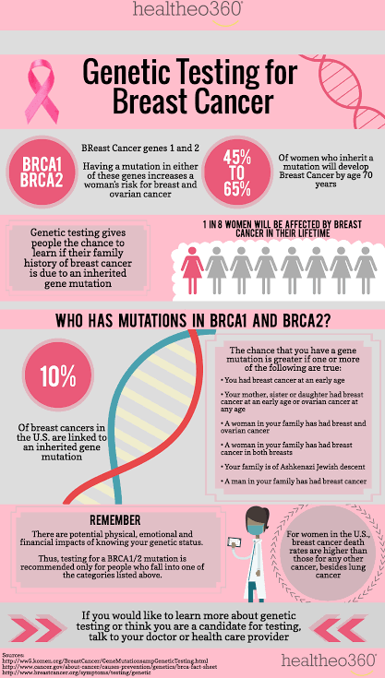
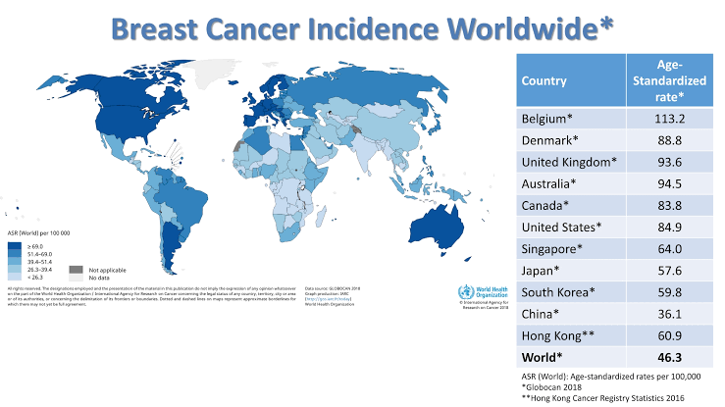
Problem
Breast Cancer is one of the leading killer disease among women
Can Machine Learning Model be used for determining a breast tumour is malignant or not??

Slide 2
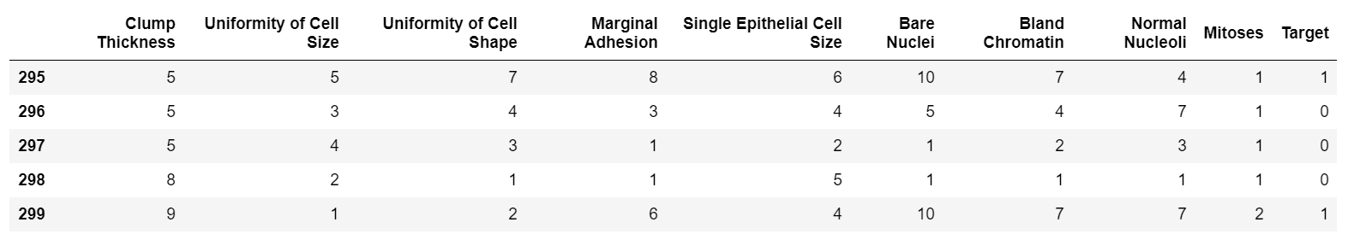
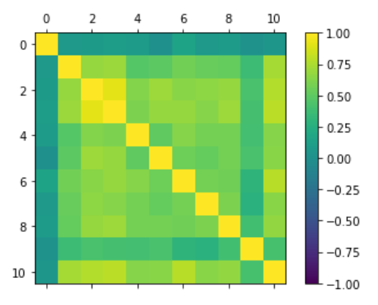
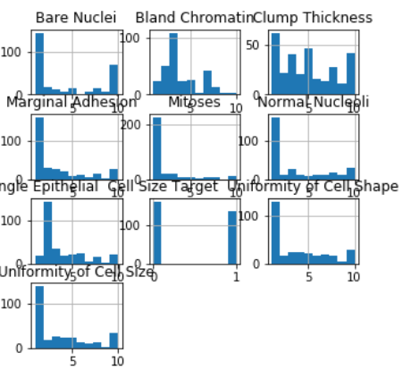
Data Understanding

Slide 3
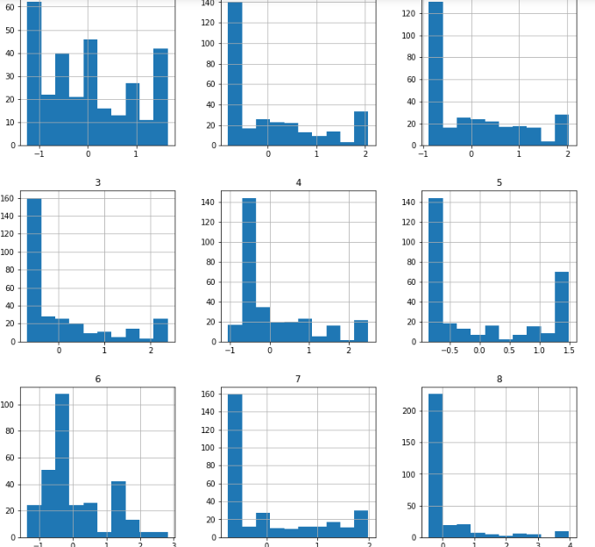
Data Pre processing
Pre processed data using Standard Scaler
Original dataset

Slide 4
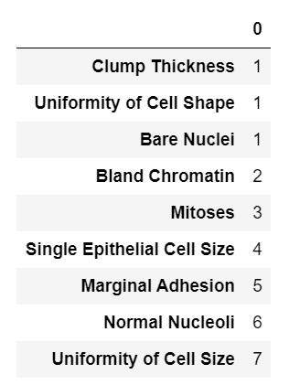
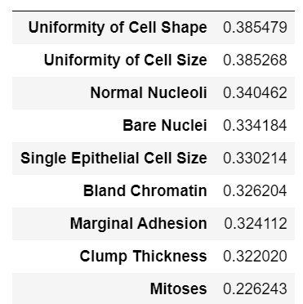
Feature Selection
Top features using PCA
Top features using RFE

Slide 5
Model
Proposed model
Using Standard Scaler, PCA, n=20
KNN: 0.9600000000000002 AUC: 0.984 (0.029)
SVM: 0.9600000000000002 AUC: 0.971 (0.049)
C0 = benign “0” : 163
C1 = malignant “1” : 139
Baseline accuracy = 0.63 using PCC

Slide 6
Testing different models
USING NORMALIZER | Using rescaled | Using rescaled, PCA, n=30 | Using Standard Scaler, PCA, n=20
LR: 0.866667 (0.080277) LDA: 0.853333 (0.081921) KNN: 0.893333 (0.074237) CART: 0.873333 (0.067987) NB: 0.890000 (0.063333) SVM: 0.876667 (0.078951) | LR: 0.943333 (0.039581) LDA: 0.930000 (0.056667) KNN: 0.960000 (0.032660) CART: 0.920000 (0.045216) NB: 0.940000 (0.041633) SVM: 0.953333 (0.033993) | LR: 0.9499999999999998 LDA: 0.9333333333333332 KNN: 0.9533333333333333 CART: 0.9166666666666667 NB: 0.9433333333333332 SVM: 0.9566666666666667 | LR: 0.95 KNN: 0.9600000000000002 AUC: 0.984 (0.029) SVM: 0.9600000000000002 AUC: 0.971 (0.049)

